Slide 1
Software Engineering 5324 OL1 Group Project Review
Members: Preston Kelly Subash Kharel Scott Willis

Slide 2
What was the Group Project
What is the goal?
A team of 2-3 members develop a web application using a database
For example: eShop, reservation system, rental cars, etc.
The teams must use Java, git, Maven, and a Test Framework.
Each team will also need to establish a git repository and a form of issue or ticket tracking such as GitHub
The data model for the project must have at least 7 entitites
At least 1 one-to-many and 1 many-to-many entities

Slide 3
BearBooks
What is it?
A web application that would allow for a staff to monitor and update a database that contains all the books owned by the buisness
What was our Goal?
A working web application prototype that would allow for unique users to register, log in, log out, checkout, update, add, and delete books form the database.

Slide 4
What will we Cover?
The Design
Both Front End and Backend
The Case Study
What Use Cases did we test?
Conclusion
Our thoughts and Opinions
Demonstration
References

Slide 5
Design
Front End
Built Upon the Angular Framework
Allowed for a quick and efficient frontend to be developed to allow for sufficient time to integrate the Back end of this project
Back End
We have a fully functioning Create, Read, Update, Delete (CRUD) function service
All Data Model have validation Checks
Swagger integration
Currently running with a in-memory database (H2)

Slide 6
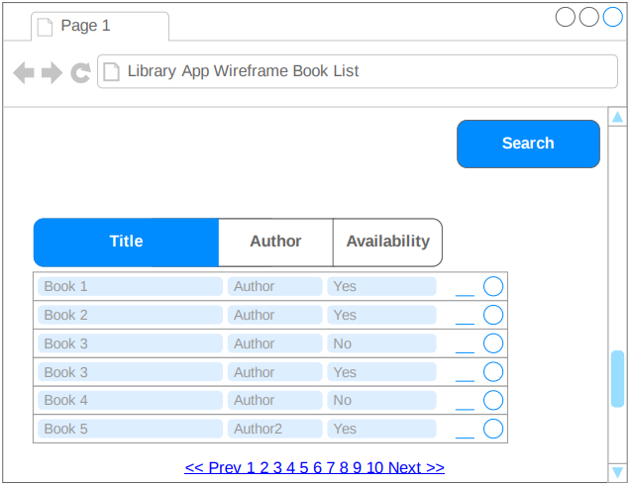
Front End Concept to …
The wireframe design was create to allow for an easy to create, more importantly an easily user friendly design.

Slide 7
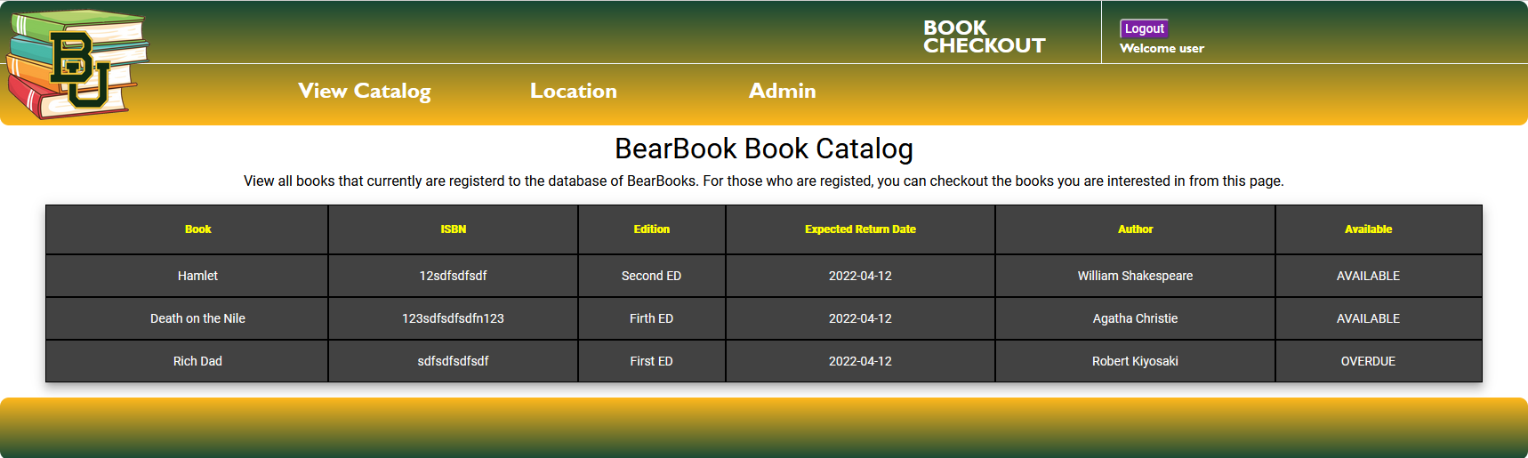
… To Front End Reality
Ultimately, once we finished the front end design and integrated the backend functionality, we had a user friendly application.

Slide 8
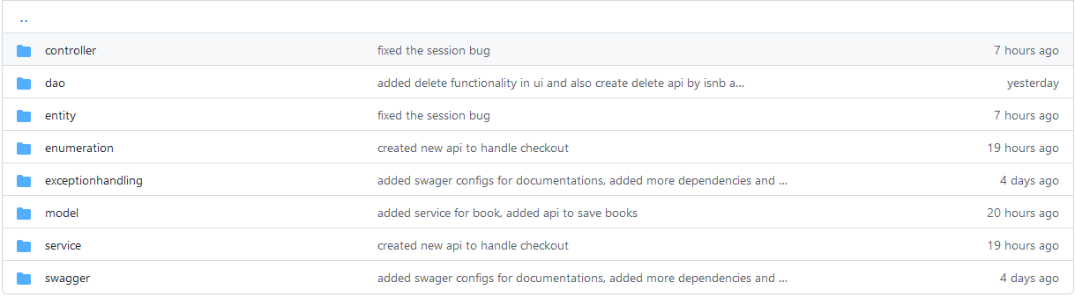
The Back End Basics …
We implemented CRUD functionality into are application to allow us to have the required functionality for our application.

Slide 9
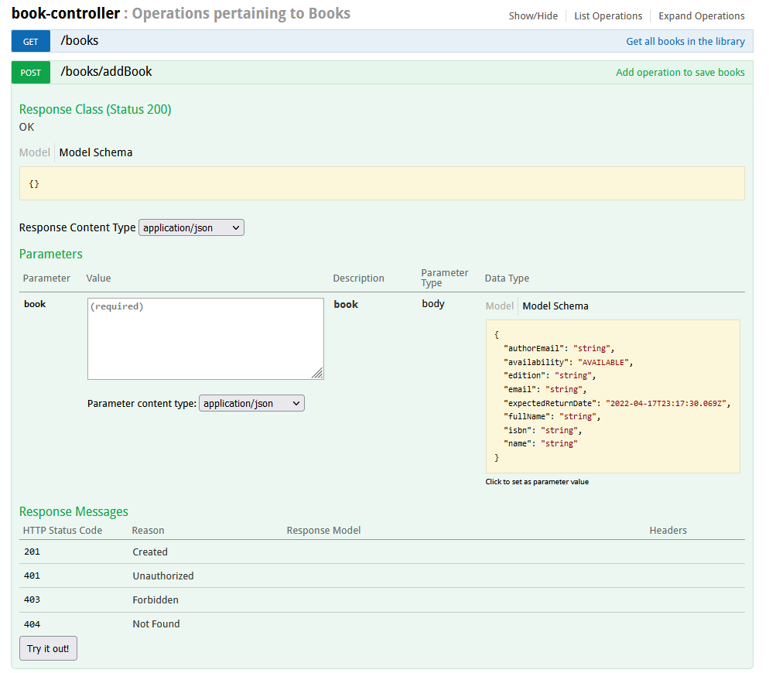
… and Standardizing the Back End
We also implemented Swagger into our Back End. This allows for easier standardization and testing for our development team as we worked on this application.

Slide 10
Use Cases
What we tested:
Registration
Login
Book Checkout
Adding a Book
Updating a Book
And Deleting a Book
Video Demonstration
Can be found within our repository under the Use Cases Directory

Slide 11
Conclusion
Successfully created and ran our Application
Dedicated Front and Back End to allow for easier upgrades in the future
Complete the milestones the team set out to attain

Slide 12
Video Demonstration
Video Demonstration can be found under the Project Demonstration folder of the GitHub Repository
This url will be posted in the Resources Slide

Slide 13
Resources
Final Repository:
https://github.com/willissa2121/library_checkout_proj_3
Angular Information:
https://angular.io/
Swagger Information:
https://swagger.io/solutions/api-design/

Slide 14
Resources Cont.
2nd Repository:
https://github.com/willissa2121/library_checkout_proj_2
1st Repository:
https://github.com/willissa2121/library_checkout_proj

